Slide 1
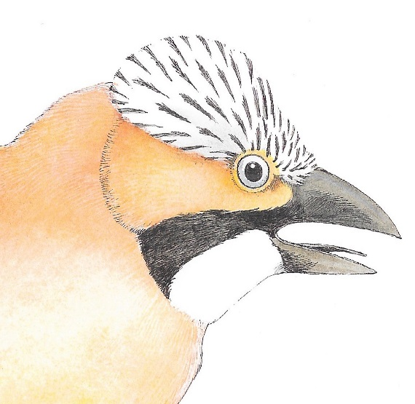
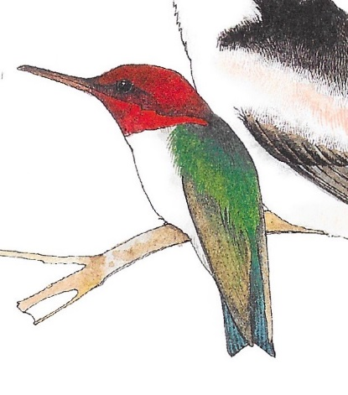
Punctuating Direct Speech
The King of the Birds
How do we choose a King?
I think there should be a competition.

Slide 2

Punctuating Speech
Speech bubbles can show us what a character is saying.
Let’s decide what competition we should have.
The words said are called direct speech.
“Let’s decide what competition we should have ,”
said the Jay .
Bubbles take up too much room when we are writing, so we use speech marks.
Speech marks work in pairs to hug the direct speech.
We report who is speaking using a reporting clause.
Speech marks are also called inverted commas.

Slide 3
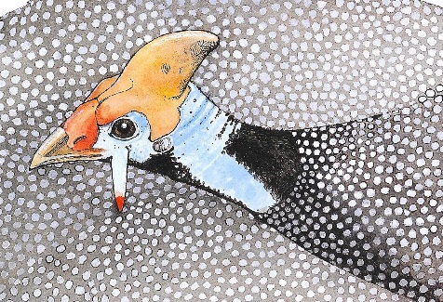
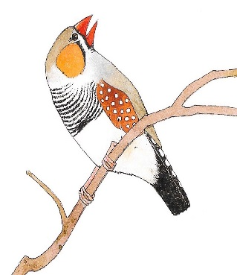
Punctuating Speech
Guinea fowl
It should be about spots.
“It should be about spots,” said the guinea fowl
“It should be about colour!,” replied the zebra finch.
It should be about colour!
EXAMPLE
Zebrafinch
Write this conversation as punctuated speech.
Remember to hug the direct speech with speech marks
and add reporting clauses.

Slide 4
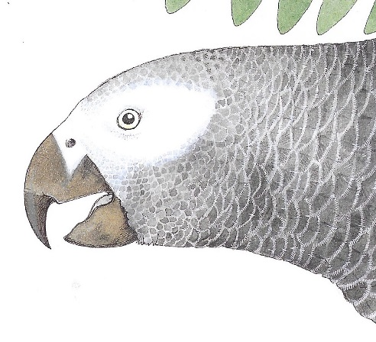
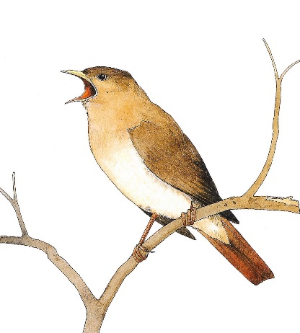
Punctuating Speech
“A race is a good idea,” said the Parrot, peering at them from his branch.
“Okay! Okay!,” tweeted a smaller bird, who was very excited about the competition.
EXAMPLE
You can also add actions and descriptions.

Slide 5

Punctuating Speech – capital letters open direct speech
Direct speech begins with a capital letter, even if it is in the middle of a sentence.
The humming bird said, “Ready, steady, go!”
The kiwi said, “They’re off.”
It is the beginning of the speaker’s sentence so a capital letter is used.

Slide 6
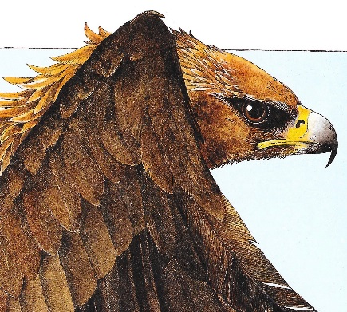
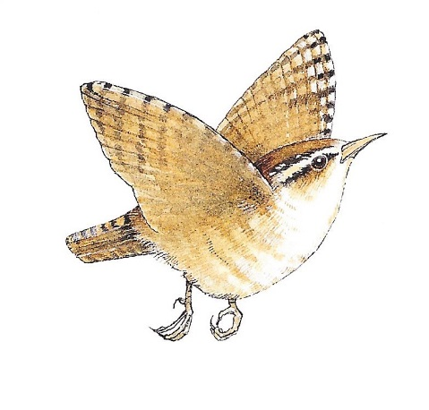
Punctuating Speech – commas separate clauses
Direct speech and reporting clauses are usually separated by a comma.
“I am winning ,” cried the Eagle.
The Wren smiled, “No, I am!”
The comma is placed at the end of the first clause.
The speech marks follow the comma.

Slide 7

Punctuating Speech – exclamations and questions
If the speech ends in a ! or ? we do not need a comma after the speech.
“Did the Wren cheat?” asked all the birds.
“No, he’s the winner!” boomed Parrot.
The punctuation is placed inside the speech marks.
The punctuation belongs to the spoken words – they tell you how to say them.

Slide 8
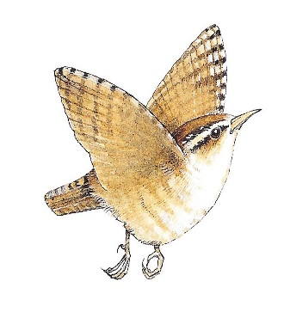

Punctuating Speech – a new line shows a change of speaker
I am so pleased I won.
“I am so pleased I won,” said the Wren.
Well done!
“”Well done!” commented the Nightingale
“I will try to be a good King,” said the Wren.
I will try to be a good King.
The Nightingale chirped, “I bet you’ll be brilliant”
I bet you’ll be brilliant.
We show each change of speaker by starting a new line.
This makes it clear when the speaker changes.

Slide 9

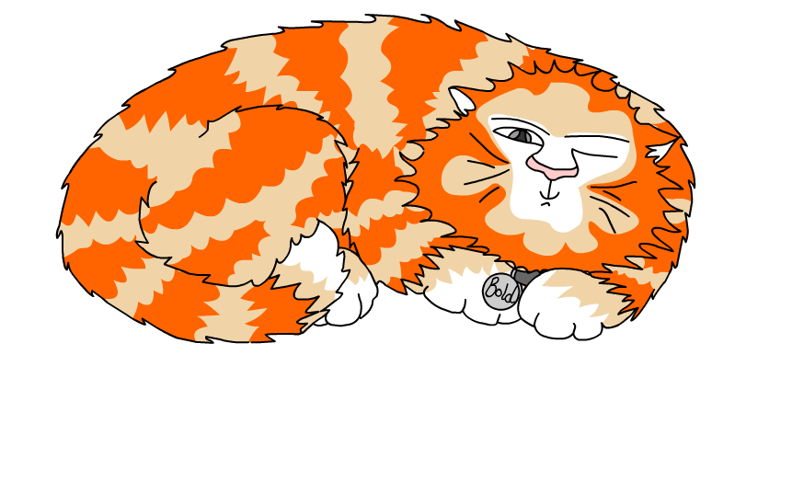
Explore more Hamilton Trust Learning Materials at https://wrht.org.uk/hamilton/ .

