Slide 1


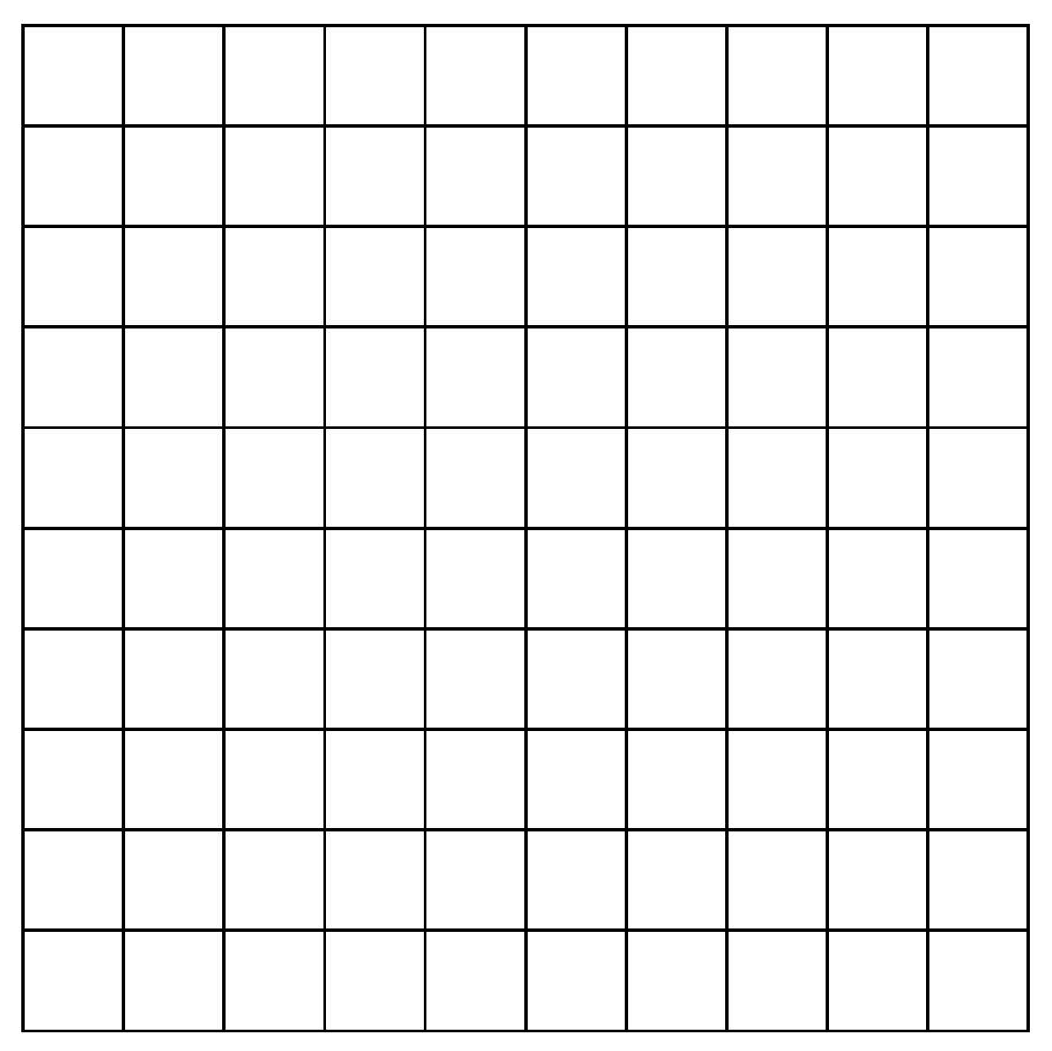
Find equivalent fractions, decimals and percentages.
What fraction of the big square is 1 little square?
How can we write this as a decimal?
¹/₁₀₀ = 0.01
What is this as a percentage of the whole square?
¹/₁₀₀ = 1%

Slide 2

Find equivalent fractions, decimals and percentages.
What fraction is shaded now?
How can we write this as a decimal?
And as a percentage?
¹⁰/₁₀₀, ¹/₁₀, 0.1, 10%
²/₁₀, ¹/₅, 0.2, 20%
Write:
- the fraction(s) shaded (simplifying as much as possible);
- the decimal shaded;
- the percentage shaded.
⁵/₁₀, ¹/₂, 0.5, 50%
Write:
- the fraction(s) shaded (simplifying as much as possible);
- the decimal shaded;
- the percentage shaded.

Slide 3
Find equivalent fractions, decimals and percentages.
²⁵/₁₀₀, ¹/₄, 0.25, 25%
How much is not shaded?
Write:
- the fraction(s) shaded (simplifying as much as possible);
- the decimal shaded;
- the percentage shaded.
⁷⁵/₁₀₀, ³/₄, 0.75, 75%

Slide 4
Find equivalent fractions, decimals and percentages.
Write the equivalent fraction, decimal and percentage.
¹⁵/₁₀₀, ³/₂₀, 0.15, 15%
¹¹/₁₀₀, 0.11, 11%

Slide 5
Find equivalent fractions, decimals and percentages.
Write the equivalent fraction, decimal and percentage.
⁹/₁₀, 0.9, 90%
⁹⁵/₁₀₀, 0.95, 95%

Slide 6
Find equivalent fractions, decimals and percentages.
²/₅ 0.3
We can write both as decimals (0.4 and 0.3) or both as tenths, ⁴/₁₀ and ³/₁₀, or even as percentages!
Which is more?
How can you compare them.
Now use equivalence to compare these.
³/₄ and 60%
0.25 and ³/₁₀
75% and 60%
so ³/₄ > 60%
25% and 30%
So 0.25 < ³/₁₀
Today’s tip is to use equivalence to compare fractions, decimals and percentages.

