Slide 1
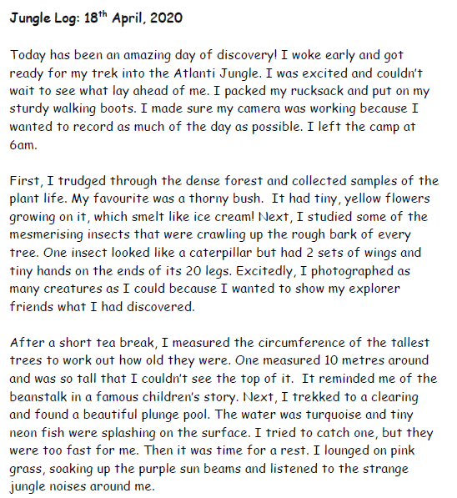
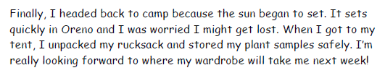
Last term, we read the log (diary) of the explorer who visited a jungle.
Let’s remind ourselves of what happened.

Slide 2

This week we will be writing our own log about the jungle
we are in so think hard about all the things that might
be in your jungle.
Draw what you would see through my telescope and make notes on the things you can see, hear, smell, taste.

Slide 3
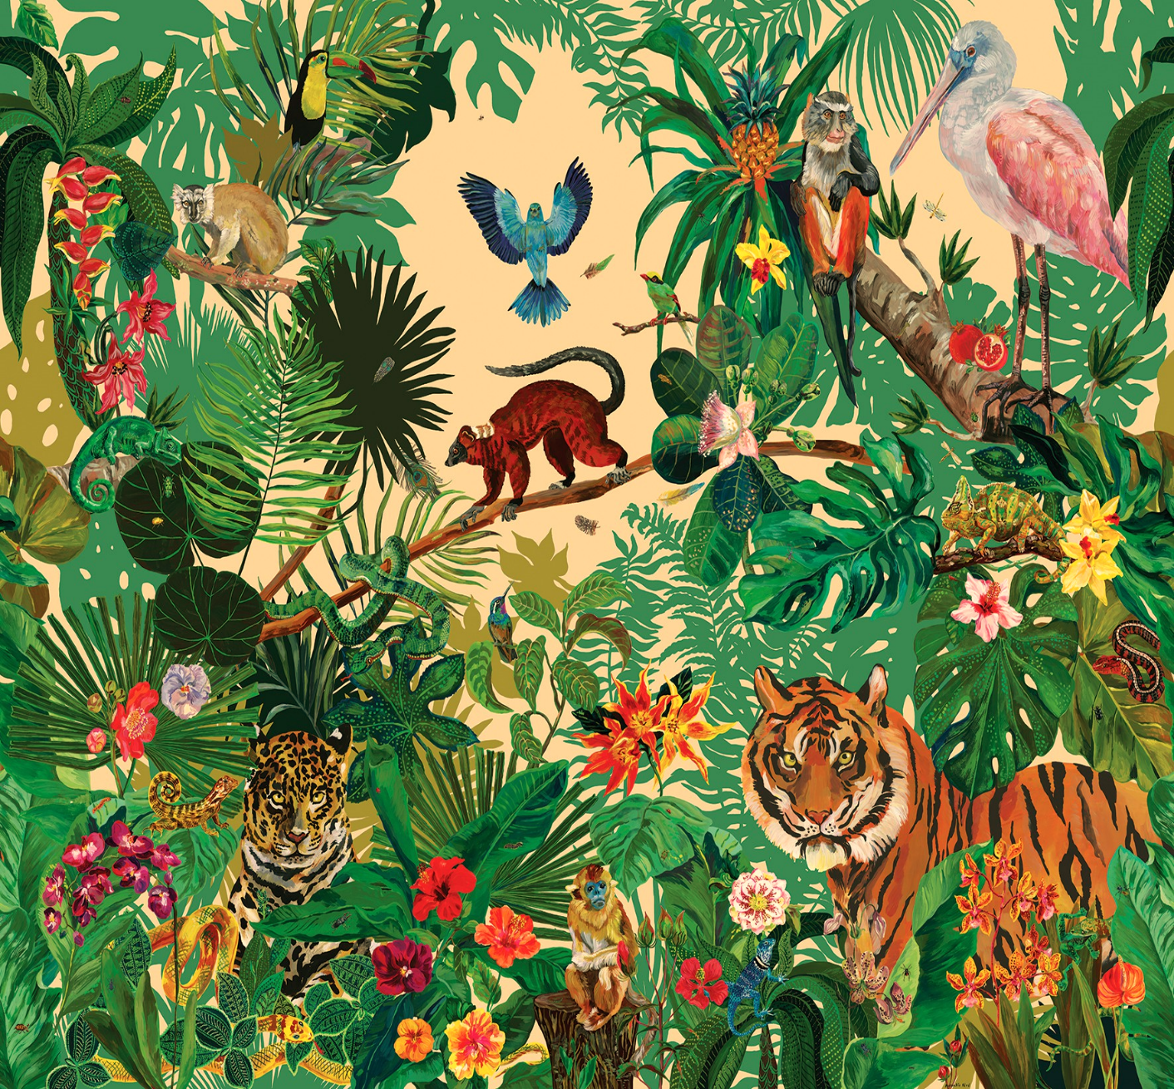
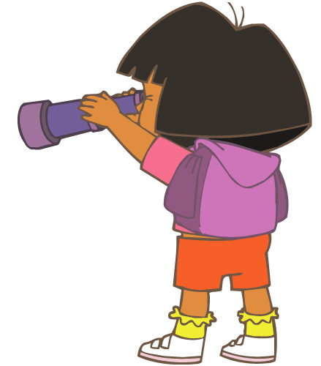
My jungle is called Nozama.
peach sky
2 burning suns.
The animals look like animals we know but can talk and change colour like chameleons.
warm and pink rain
air smells like bubblegum
flowers taste of candyfloss and plums (except the yellow flowers, they taste like ear wax)
All the animals talk at
once and it hurts my ears.
The trees can walk.
Here is an example:

