Slide 1
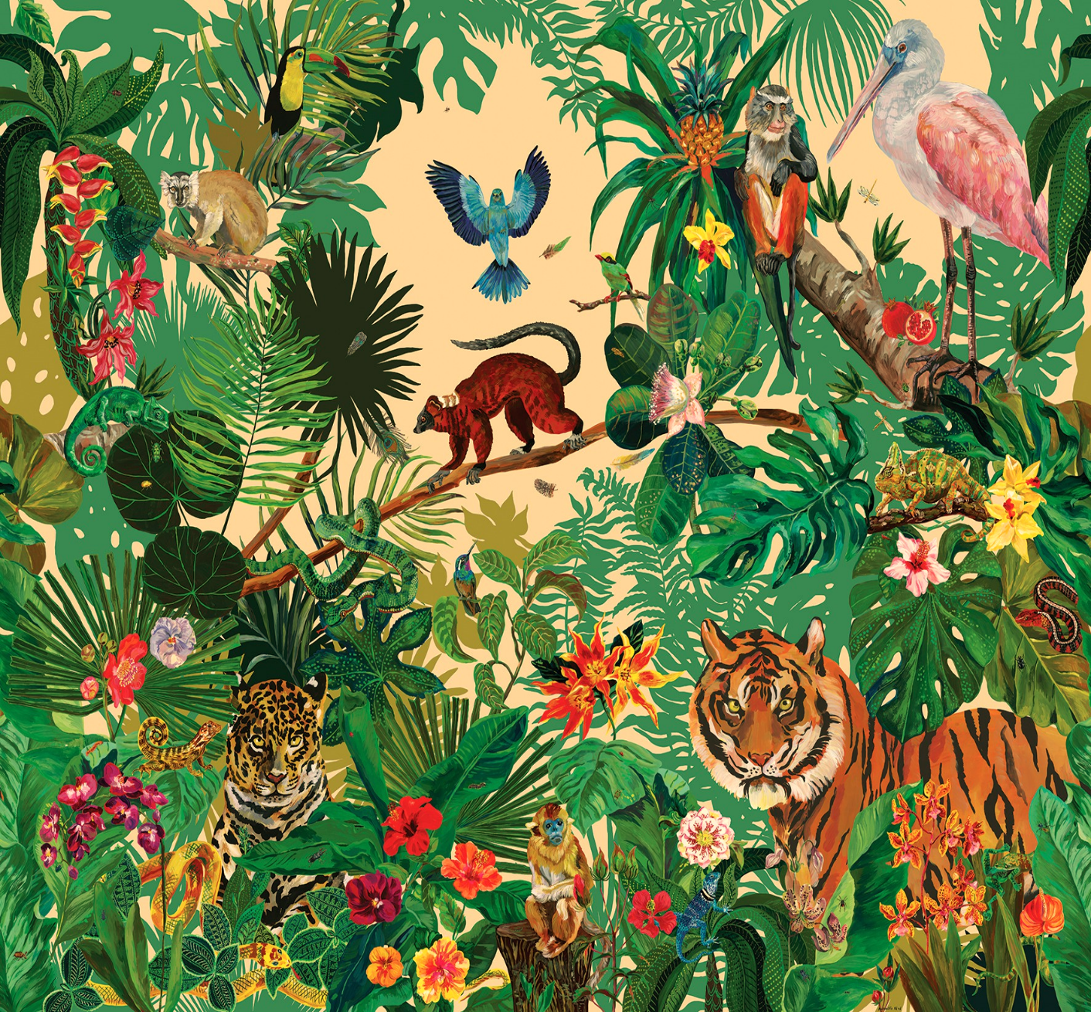
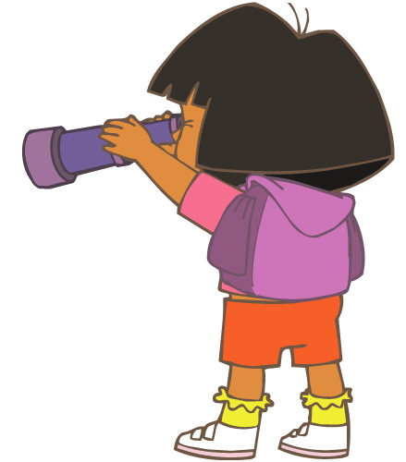
Here is an example of what we did yesterday:
My jungle is called Nozama.
peach sky
2 burning suns.
The animals look like animals we know but can talk and change colour like chameleons.
warm and pink rain
air smells like bubblegum
flowers taste of candyfloss and plums (except the yellow flowers, they taste like ear wax)
All the animals talk at
once and it hurts my ears.
The trees can walk.

Slide 2
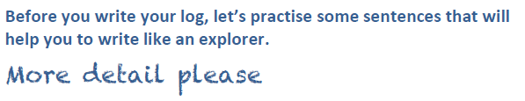

Slide 3
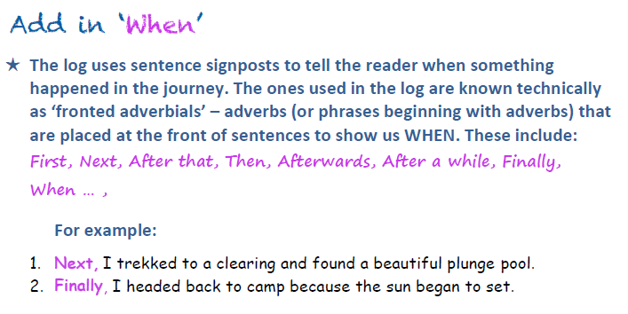

Slide 4

First,
unusual

Slide 5
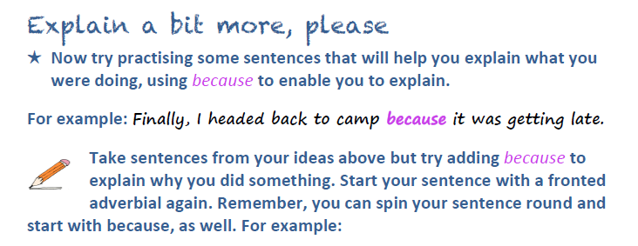
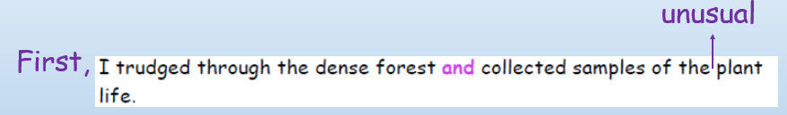
because it’s important that I learn
which plants would make me shrink
to the size of an ant.

Slide 6
Using your notes write at least another 3 full sentences including a fronted adverbial (time word at
start of sentence) and because or and/but.

