Slide 1
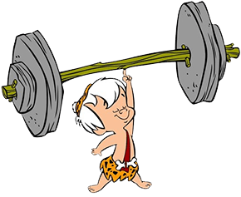
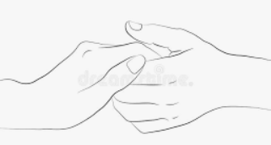


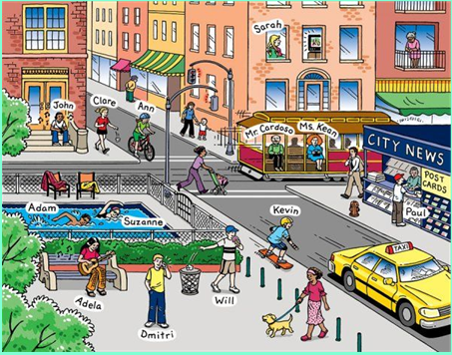


Grammar Starter
Choose one person.
1. Write a simple sentence. 2. Write a compound sentence 3. Write a complex sentence.

Slide 2
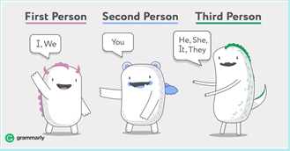
Today we are going to write the first half of our log
The log needs to be in first person.
What does first person mean?
Our log must be in past tense as well as we are writing our log in the evening describing what
happened that day.
Week 1 Day 4

Slide 3
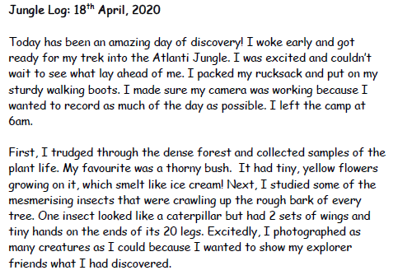
We are going to write the first 2 paragraphs today.
Let’s look at this good one again for ideas before looking at our plans.
First paragraph
Describe how you felt before you set out.
Say what you packed and why.
Say what time you left camp at.
Second paragraph
First, describe your journey into the
jungle
Next, what did you study?
Excitedly, I what did you do and why?
Week 1 Day 4

Slide 4
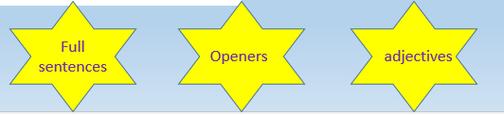
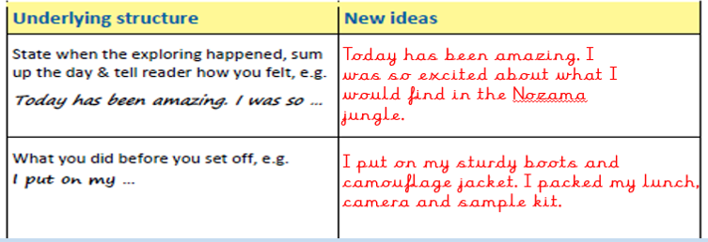
Look at your plan from yesterday.
Remember, your plan is not full sentences and you need to add more detail.
Today has been amazing! I was so excited about what I would find in the Nozama jungle that I was awake at 4am! After
a delicious breakfast of earwigs in peanut butter, I put on my tall, sturdy boots so a slithery snake wouldn’t nip my toes
and my peach and green camouflage jacket so I could hide in the bushes. I packed my favourite lunch (banana and pickle
sandwiches), my camera and my sample kit in my backpack. When I was ready, I left a note for my teddy bear to say
where I was going and left camp at 6am.

Slide 5
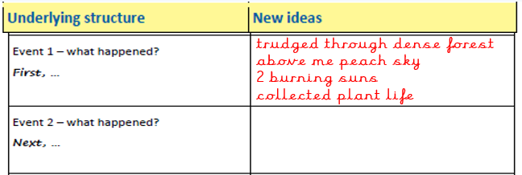
This is as far as we are going today with our writing.
studied the flowers
put them in my testing kit to see if safe to eat
taste of candyfloss and plums
yellow- ear wax
excitedly videoed a tree walking
First, I trudged through dense forest and began to collect some samples of plants. Above me, the peach sky peered through
the leaves. Two burning suns shone down and made me feel prickly and sweaty. Next, I studied the flowers and put them
in my testing kit to see if they were safe to eat. They were! They tasted of candyfloss and plums but the yellow ones tasted
disgustingly of ear wax! Excitedly, I videoed a tall, green tree walking! It was walking! I had to video it because my friends
wouldn’t believe me if they didn’t see it for themselves. As it slowly walked, it creaked very loudly but that made sense
as it’s wooden of course.
Week 1 Day 4

Slide 6
Now, it’s your turn.
Look at your plan.
Look at your notes, work and describing sentences you’ve done about the jungle.
Use all this plus the structure I have shown you and write the first 2
paragraphs.
Remember: Capital letters and full stops!

