Slide 1
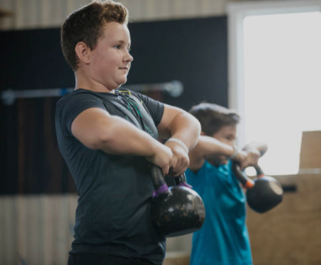

Session 6
‘Bouncebackability’

Slide 2
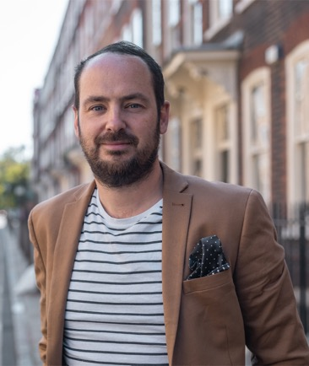
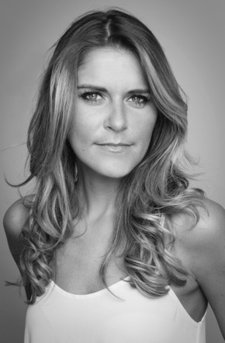
We are moving on to Session 6 now. We hope you are learning about ways in which you can be awesome as you ‘go big’. We have a new word to look at today – ‘bouncebackability’!
Matthew Burton
Gemma Oaten
As a headteacher, and a teacher before that, Matthew knows a lot about the importance of bouncing back.
Gemma has to use ‘bouncebackability’ all the time in her line of work – when you mess up your line, you have to go again!

Slide 3
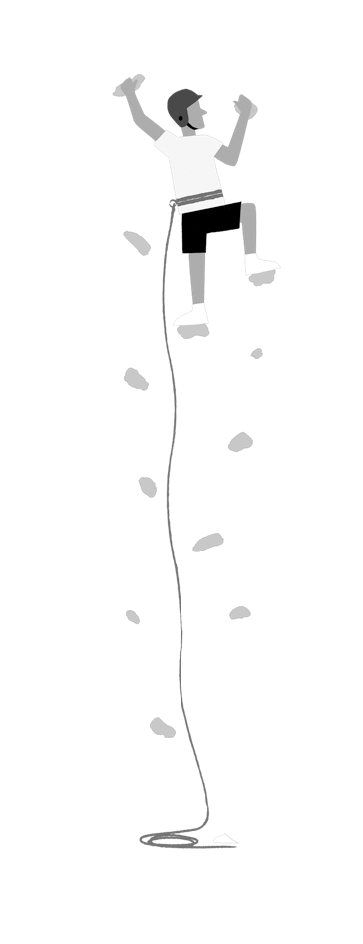
In Session 5, we looked at being lost emotionally and physically, and we gave you some tips around the first few days of the big move to secondary school.
We explored ways of handling your nerves, excitement and emotion – remember the Triangle of Trust?
You are learning how to be awesome – it doesn’t just happen! You have to work on some of these things and keep your mind in the right mindset.

Slide 4
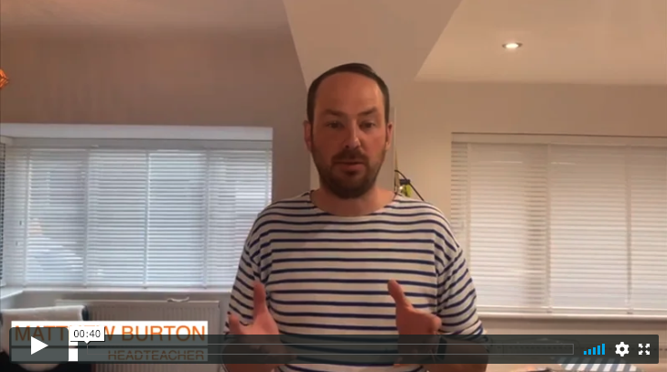

Here is Matthew Burton to introduce today’s session:
If you are reading alongside these sessions, then you can read up to page 63.

Slide 5
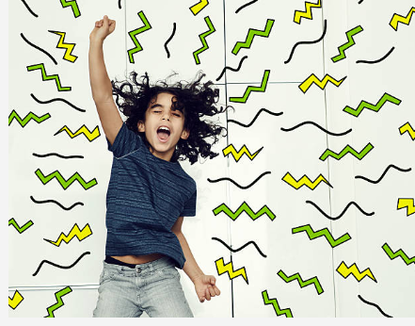
What is ‘bouncebackability’?
It is something you have to work on, develop, practise, exercise and sharpen.
It is often called ‘resilience’ or ‘grit’.
If you work on this, everything else falls into place!

Slide 6
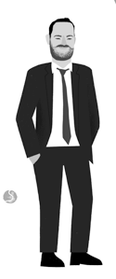
What is ‘bouncebackability’?
“We could go on for years and years about this, but if we’re going to boil it down to one thing I think you have to work on, develop, practise, exercise and sharpen, it’s this: bouncebackability. People call it various things – it can be known as ‘resilience’ or ‘grit’ or simply ‘thatwasn’tveryniceorverygoodbutI’mnotgoingtogiveupI’mgoingtotryagain’.”
‘Go Big’ page 57

Slide 7
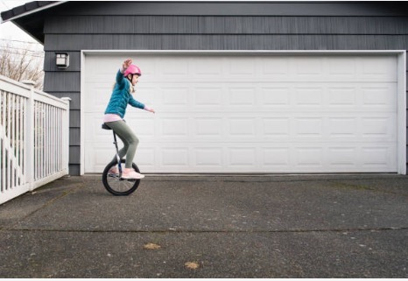
Let’s understand your expectations vs reality
Nothing comes easy. You will make mistakes along the way.
Make sure you have clear expectations about what can happen in reality.
Expectations:
I’m never going to fall off! This is so easy!
Reality:
I fell off straight away and barely stayed on the bike for more than a few seconds!

Slide 8
How do you handle bouncing back?
In your workbook, answer the following questions/finish the sentences:
I have shown ‘grit’ when…
I need to show more determination when…
How do you handle making a mistake? What is your reaction?
Think of a time when you made a mistake, were you kind to yourself?

Slide 9
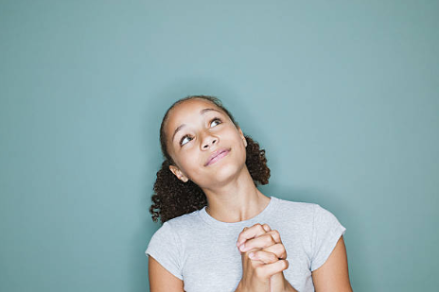
When things go wrong…
The easy thing to do would be to say everyone else is wrong, insist you’re right, refuse to take any feedback from anyone and keep doing what you’re doing. The tough thing to do – and the whole point of bouncebackability – is to accept
“I wasn’t very good”.
Matthew Burton, ‘Go Big’
Read more on page 59

Slide 10
At secondary school, you will make mistakes because that is how you learn and because you are just getting the hang of things.
You might handle a disagreement badly.
You might get offended more than you should.
You may fall out with people occasionally.
You might not score 100% on a test.
You might forget to hand your homework in on time.
You might not bring the right equipment.
Remember what Matthew Syed said about a growth mindset? Turn these things into learning opportunities.

Slide 11
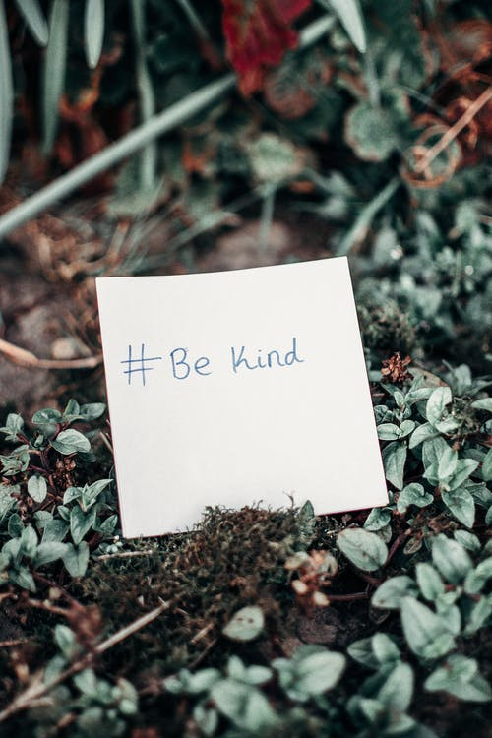
Are you kind to yourself?
You are going to have days where you feel fed up and times when you are upset.
You may panic about the future.
You may feel overwhelmed.

Slide 12
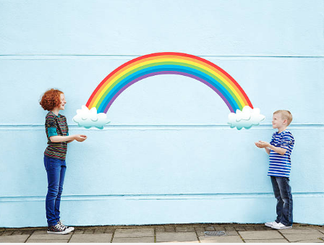
Are you kind to others?
Everyone has worries and sometimes people don’t want to talk about them, but we can make a HUGE difference to the lives of other people with KINDNESS.
“Unfortunately, we can’t fix everything for everyone, but what we can do, and what we should do every day, hour, minute and second, is be kind.”
Matthew Burton

Slide 13
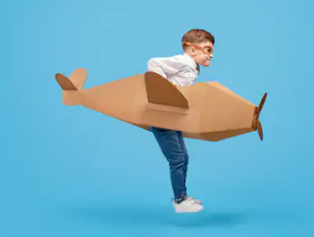
"Be nice, work hard, bounce back, and all will be fine.
Go get ‘em!”
Matthew Burton

Slide 14

What does ‘work hard’ and ‘be kind’ mean?
Fill in the person outline in your workbook with all of the things that you can do to show you are working hard.
Now think about what you can do to be kind.
How many of these things do you do already?
Highlight the ones that you would like to do more of!

Slide 15
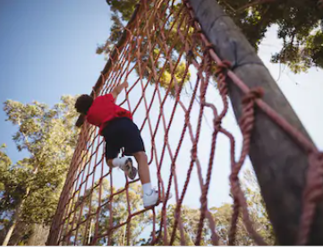
Effort and enthusiasm are super important
In life we MUST try. Teachers won’t mind if you get things wrong, but they will mind if you don’t put effort in to try in the first place.

Slide 16
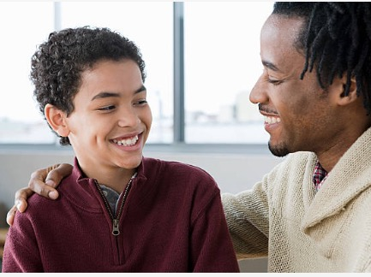
Whatever you do, don’t give up.
There will be:
tasks you find hard
homework you can’t do
a grade you think you don’t deserve
The best thing you can do is talk. Talk about life, things and anything you don’t understand.

Slide 17
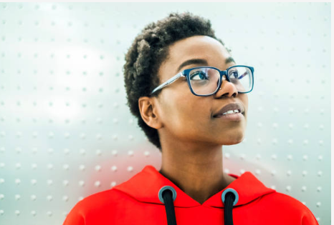
Decide who you want to be.
Develop yourself as a person.
Don’t be put off by things.
Achieve your goals.

Slide 18
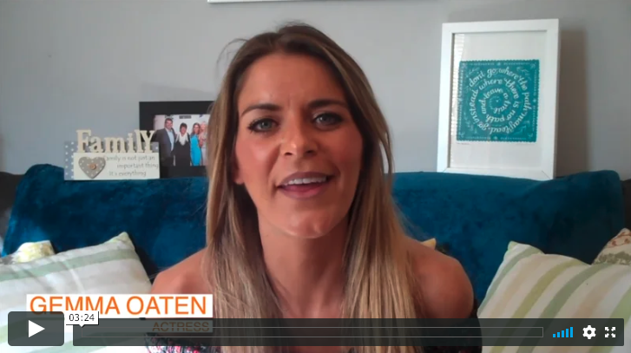
Here is Gemma to give you some advice on bouncing back. It is something we all need to do.

Slide 19
© 2020 The PiXL Club Ltd and Hachette UK
This resource may be shared with any primary school Year 6 student in its current form, and parts thereof, to enhance your transition work with students. All opinions and contributions are those of the authors. The contents of this resource are not connected with, or endorsed by, any other company, organisation or institution.
If there are any inadvertent omissions or errors in the acknowledgements or usage, this is unintended and we will remedy these on written notification.
Hachette UK own 'You Are Awesome' by Matthew Syed and 'Go Big' by Matthew Burton, which may be purchased by individuals and schools, should they wish to do so to enhance these resources for students. 'You Are Awesome' illustrations copyright © Toby Triumph. 'Go Big' illustrations copyright © Chris Madden.

