Slide 1

Perfect and Progressive Form
Past and present tense (simple)
Perfect form of verbs
Progressive form of verbs: present and past

Slide 2
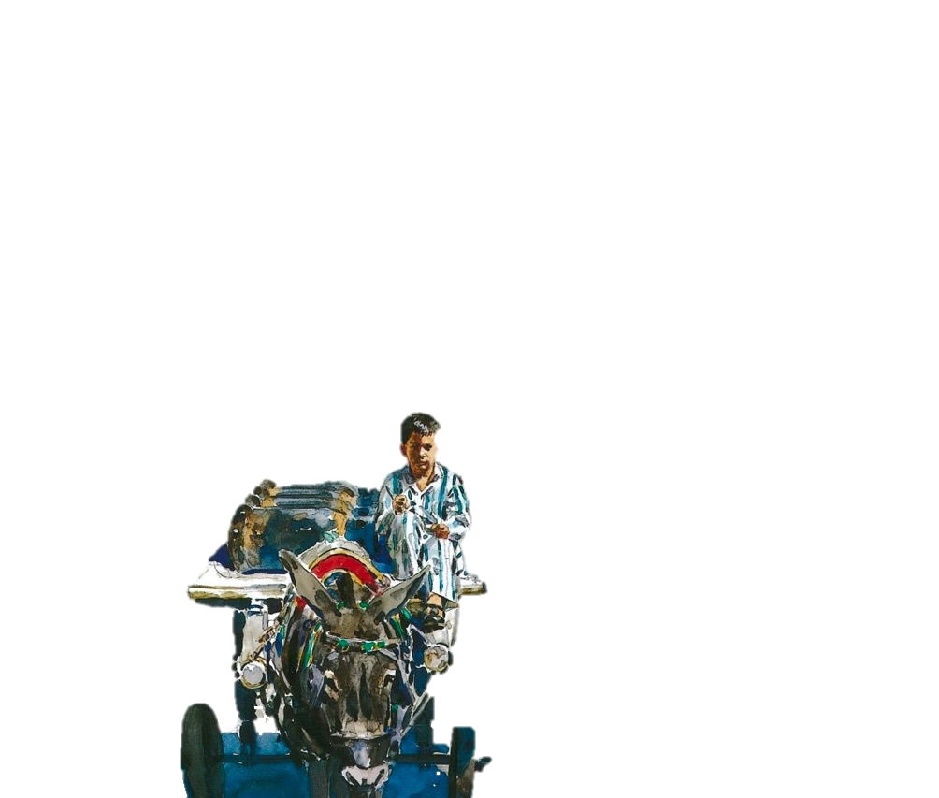
Verbs
Verbs indicate that someone or something is
doing, feeling or being.
verbs
verbs
The donkey pulls the cart.
He is hungry.
Ahmed delivers gas.
I’d absolutely love to visit Cairo.
Usually verbs have the name of a person or thing or a pronoun in front of them.
Can you spot these?

Slide 3

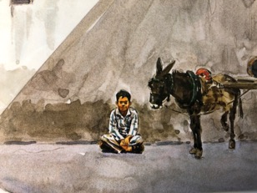
Verbs have a tense.
They can tell us when the action happened.
Ahmed started his work early.
In the past
or in the present.
They rest by the wall.
Write a sentence in the present tense.
Example
Rewrite it in the past tense.
They saw the lunch cart.
They see the lunch cart.

Slide 4

For regular verbs we add ed to show that an action is
in the past and complete.
The donkey pulled the cart until lunchtime.
watched
brayed
waited
plodded
listened
trotted
delivered
Irregular verbs take different forms when showing past tense; we learn them through hearing them used.
found
caught
ate
was

Slide 5
Perfect Form
The perfect form is created by using the present or past tense of ‘have’ with the past participle of the verb.
I have journeyed.
He has taught me how to work.
Ahmed has shared his secret.

Slide 6
Perfect form
The perfect form of the past tense suggests that
a past action is still affecting the present.
still affecting the present.
He told me in the past and I still think about it now.
Simple past | Perfect form
My father told me.
My father has told me.
He showed me in the past and I still can picture him now.
He showed me.
He has shown me.
He took me to each place.
He has taken me to each place.
He took me to each place in the past and I still remember when I go there now.

Slide 7
Perfect form
There are two forms of the perfect form of the past tense.
In the past, he had finished and, in the past, he is still finished.
Present perfect | Past perfect
The boy has finished work.
The boy had finished work.
In the past, I told my secret and, in the past, it is still told.
I have told my secret.
I had told my secret.
In the past, Ahmed enjoyed the day and, in the past, he still enjoys it.
Ahmed has enjoyed his day.
Ahmed had enjoyed his day.

Slide 8
Perfect form of verbs: present and past perfect
Simple past | Present perfect | Past perfect
He talked
He has talked
He had talked
It rattled
It has rattled
It had rattled
Hassan laughed
Hassan has laughed
Hassan had laughed
I watched
I have watched
I had watched

Slide 9
The progressive form is continuous.
It suggests that the action continues,
for a period of time,
All day, I was waiting for the evening to come.
or continues at the time something else happens or happened.
I was waiting for the evening to come while I worked.
This can be in the present (happening now)
or in the past (happened then).

Slide 10
Progressive form of verbs: present and past progressive
Present | Present progressive | Past progressive
He walks
He is walking
He was walking
It mingles
It is mingling
It was mingling
The boy smiles
The boy is smiling
The boy was smiling
I stare
I am staring
I was staring

Slide 11


Explore more Hamilton Trust Learning Materials at https://wrht.org.uk/hamilton/ .

