Slide 1
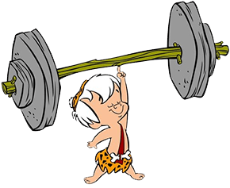


Let’s review: complex sentences.
A complex sentence includes a main clause and a subordinating
conjunction to make a subordinate clause. The main clause must make
sense on its own but the subordinate clause relies on the main clause
to make sense.
I am very strong because I exercise every day.
because I exercise every day. This doesn’t make sense by itself. It is subordinate.

Slide 2
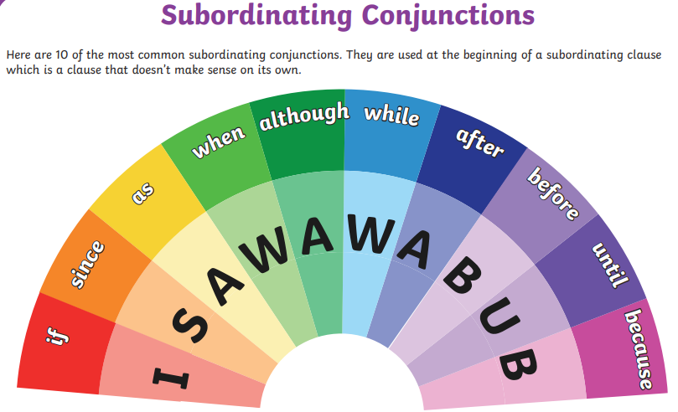

Slide 3
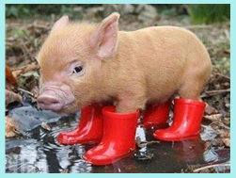

Can you write a complex sentence about this picture using a subordinate clause?
Use one of these subordinating conjunctions
to join your main clause to the subordinating
clause.

Slide 4

The piglet wore wellies because she wanted her
trotters to stay dry.
We can write a subordinate clause at the start of the sentence. Put a comma after the clause before you write your main clause.
Because she wanted her trotters to stay dry, the piglet wore wellies.

Slide 5
The piglet was not happy because she got her new wellies
dirty in the mud.
Rewrite this sentence with the subordinate clause first. Remember the comma.

Slide 6
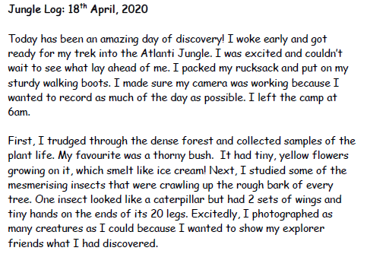
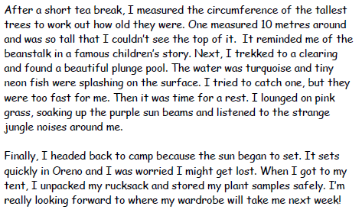
Today we are going to plan our log!
Let’s remind ourselves of what a good log looks like.
Full sentences
Openers
adjectives

Slide 7

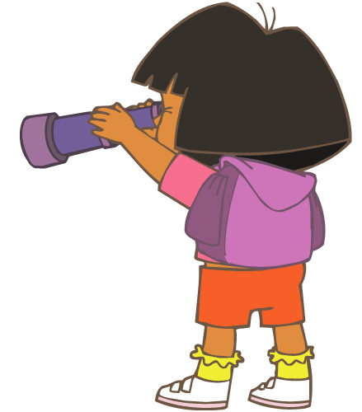
My jungle is called Nozama.
peach sky
2 burning suns.
The animals look like animals we know but can talk and change colour like chameleons.
warm and pink rain
air smells like bubblegum
flowers taste of candyfloss and plums (except the yellow flowers, they taste like ear wax)
All the animals talk at
once and it hurts my ears.
The trees can walk.
Here are some of my ideas:

Slide 8
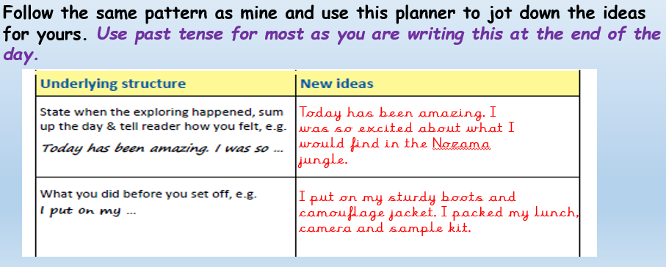
★ Now let’s imagine we have explored our new jungle and we are going to write our explorer’s log.
Look back through all the jungle work you have done so far- you can use your great ideas in your log.

Slide 9
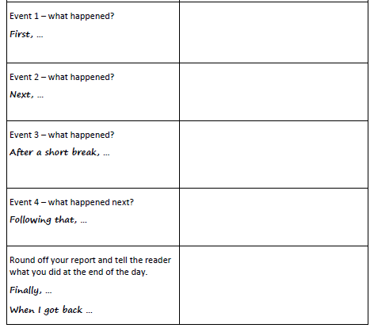
trudged through dense forest
above me peach sky
2 burning suns
collected plant life

Slide 10
