Slide 1
The tabby cat sat on the mat it watched a mouse run past.
Is this sentence grammatically correct?

Slide 2
The tabby cat sat on the mat it watched a mouse run past.
This sentence is made up of two simple sentences (two main clauses).
What are they?
Copy the main clauses or draw 2 lines under them.
Week 1 Day 5

Slide 3
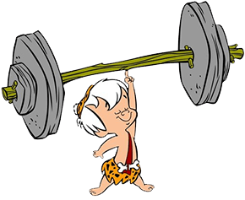
The tabby cat sat on the mat it watched a mouse run past.
What do we need to do to make the sentence correct?
Week 1 Day 5

Slide 4

The tabby cat sat on the mat it watched a mouse run past.
We can use a full stop.
Copy the main clauses and put a full stop in the right place
(hint: in between the 2 main clauses).
Capital
Capital
Week 1 Day 5

Slide 5
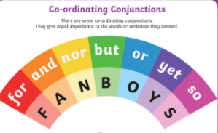
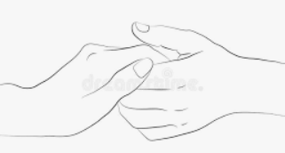
We can use a co-ordinating conjunction to
make a compound sentence.
The tabby cat sat on the mat it watched a mouse run past.
Write the main clauses out and join them with and, but or so.
Capital
Week 1 Day 5

Slide 6
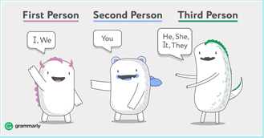
Today, we are writing 2 more paragraphs to finish our log.
The log needs to be in first person.
Our log must be in past tense as well as we are writing our log in the evening describing what happened that day.
Week 1 Day 5

Slide 7
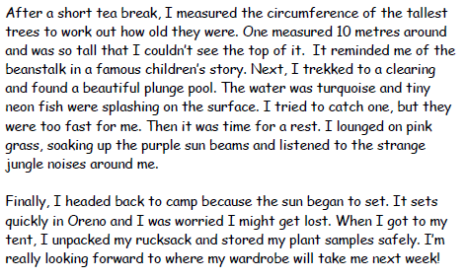
Let’s remind ourselves of what a good log looks like.
Third paragraph
After a short break, say what you
did next
Next, say where you went next
Say what you did there.
Last paragraph
Finally, I headed back to camp because
…………………………
When I got back to my tent, say what
you did.
I’m really looking forward to where my
wardrobe will take me next week!
Week 1 Day 5

Slide 8
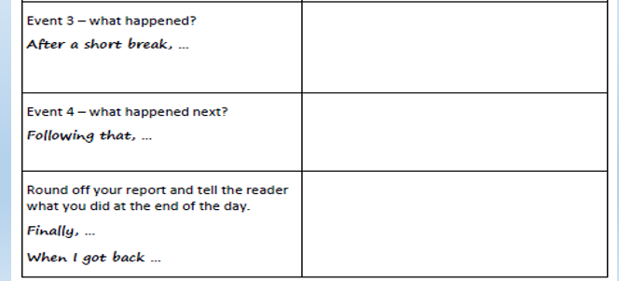
lots of animals were talking to each other very
loudly- my head ached
tried to get a sleeping tiger to wake up and
talk to me. Never wake a sleeping tiger!
A chatty cheetah told me of a beautiful, crystal
clear waterfall that would wash away my
tiger wounds
went back to camp because the warm, pink rain
was turning me the colour of a flamingo
unpacked my backpack and put my plant sample
away.
told my teddy bear about my adventures she
was very impressed
After a short banana and pickle sandwich break. I carried on into the deep jungle. I had to apologise to a tree for stepping
on its root. Luckily, he waved a branch to say it was okay. All around me, lots of animals were talking busily to each other.
A lemur and a small bear were having a furious argument over a game of chess. It made my head hurt. Suddenly, I saw
a glorious. stripy tiger. It was huge! It was at least the size of a small car. Thrilled, I ran up to it for a chat and maybe
a cuddle but sadly it was asleep. My teddy bear always told me to let sleeping tigers lie. I never knew why. Today, I found
out. I patted it on its nose but it just sneezed so I pulled its ear. At once, it opened its huge, yellow-green eyes and glared
at me. I knew I had made a terrible mistake. Before I could apologise, it pounced! Roughly, it grabbed me by my shorts and
threw me over a tree! I soared as high as the clouds before falling far far down. Fortunately, a tree caught me in its
Week 1 Day 5

Slide 9
branches and popped me safely to the ground. Sadly, my shorts were ruined and I had teeth marks on
my bottom. Following that, as I sobbed, a sleek, spotty cheetah came up to me and chatted to me. I told her
what had happened and the cheeky cheetah laughed at me! Kindly, she did tell me of a beautiful. crystal clear
waterfall that would wash away my tiger wounds. Gratefully. I went straight there and spent the rest of the
afternoon splashing under the waterfall and sleeping under a purple sunflower.
Finally, I went back to camp because it started to rain and the warm. pink rain was turning me the colour of
a flamingo. When I got to my tent, I unpacked my backpack and told my teddy about my day. Teddy was
very impressed with my samples and video but very cross when I told her about the tiger. I shouldn’t have
told her about the tiger. I’m really looking forward to where my wardrobe will take me next week!
Week 1 Day 5

Slide 10
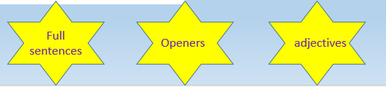
Now write the last 2 paragraphs from your log.
Look at your plan and work from yesterday.
Look at your ideas from earlier work on the jungle.
Use all this plus the structure I have shown you and write the last 2 paragraphs.
Remember: Capital letters and full stops!
Week 1 Day 5

